Slide 1




game analysis
using
mysql
A SQL PROJECT MY SHRADDHA DWIVEDI

Slide 2
Problem Statement:
1) Players play a game divided into 3-levels (L0,L1 and L2)
2) Each level has 3 difficulty levels (Low,Medium,High)
3) At each level,players have to kill the opponents using guns/physical fight
4) Each level has multiple stages at each difficulty level.
5) A player can only play L1 using its system generated L1_code.
6) Only players who have played Level1 can possibly play Level2 using its system generated L2_code.
7) By default a player can play L0.
8) Each player can login to the game using a Dev_ID.
9) Players can earn extra lives at each stage in a level.

Slide 3
Dataset Description:
Player Details Table:
P_ID: Player ID
PName: Player Name
L1_status: Level 1 Status
L2_status: Level 2 Status
L1_code: Systemgenerated Level 1 Code
L2_code: Systemgenerated Level 2 Code
Level Details Table:
P_ID: Player ID
Dev_ID: Device ID
start_time: Start Time
stages_crossed: Stages Crossed
level: Game Level
difficulty: Difficulty Level
kill_count: Kill Count
headshots_count: Headshots Count
score: Player Score
lives_earned: Extra Lives Earnedt

Slide 4
sql queries

Slide 5
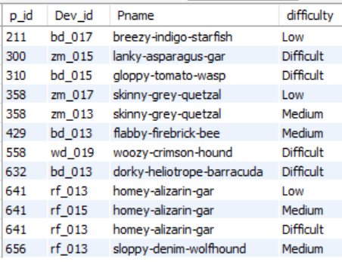
1. Extract `P_ID`, `Dev_ID`, `PName`, and `Difficulty_level` of all players at Level 0.
select p.p_id , l.Dev_id,p.Pname,l.difficulty
from player_details as p join level_details as l
on p.p_id = l.p_id
where l.Level=0
order by p_id;

Slide 6
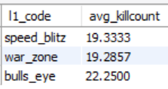
2). Find `Level1_code`wise average `Kill_Count` where `lives_earned` is 2, and at least 3 stages are crossed.
Select pd.l1_code , avg(ld.kill_count) as avg_killcount
from player_details as pd join level_details as ld
on pd.p_id = ld.p_id
where ld.lives_earned=2 and ld.stages_crossed>=3
group by pd.l1_code;

Slide 7
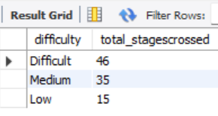
3). Find the total number of stages crossed at each difficulty level for Level 2 with players
using `zm_series` devices. Arrange the result in decreasing order of the total number of
stages crossed.
Select difficulty , sum(stages_crossed) as total_stagescrossed
from level_details
where Level=2 and dev_id like 'zm%'
group by difficulty
order by sum(stages_crossed) desc;

Slide 8
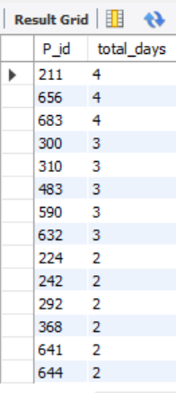
4. Extract `P_ID` and the total number of unique dates for those players who have played
games on multiple days.
select P_id , Count(Distinct(date(TimeStamp)))as total_days
from level_details
group by P_id
having Count(Distinct(date(TimeStamp))) >1
order by Count(Distinct(date(TimeStamp))) desc;

Slide 9
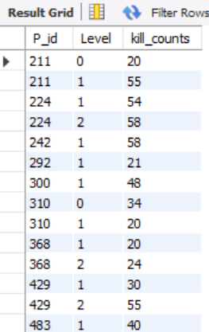
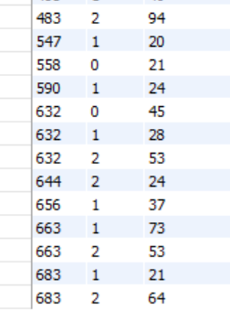
5. Find `P_ID` and levelwise sum of `kill_counts` where `kill_count` is greater than the
average kill count for Medium difficulty.
select P_id,Level,sum(Kill_count) as kill_counts
from level_details
where kill_count>(select avg(kill_count) from level_details where difficulty like 'Medium')
group by p_id ,Level
order by p_id ,Level;

Slide 10
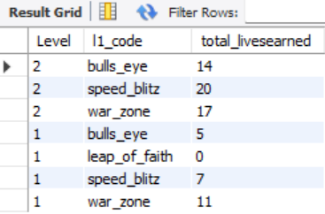
6. Find `Level` and its corresponding `Level_code`wise sum of lives earned, excluding Level
0. Arrange in ascending order of level.
select ld.Level , pd.l1_code , sum(lives_earned) as total_livesearned
from level_details as ld join player_details as pd
on ld.P_id = pd.P_id
where ld.Level>0
group by ld.Level , pd.l1_code
order by ld.Level desc;

Slide 11
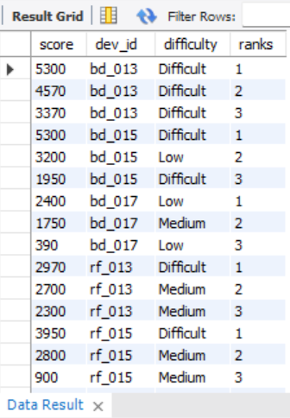
7. Find the top 3 scores based on each `Dev_ID` and rank them in increasing order using
`Row_Number`. Display the difficulty as well.
Select * from (Select score , dev_id , difficulty,
row_number() over(partition by dev_id order by score desc) as ranks
from level_details) as results
where ranks<=3;

Slide 12
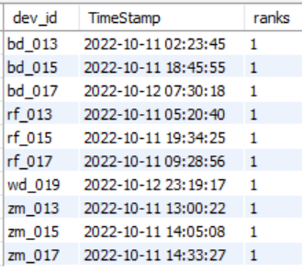
8. Find the `first_login` datetime for each device ID.
select * from ( select dev_id , TimeStamp ,
row_number()over(partition by dev_id order by TimeStamp) as ranks
from level_details) as result
where ranks=1;

Slide 13
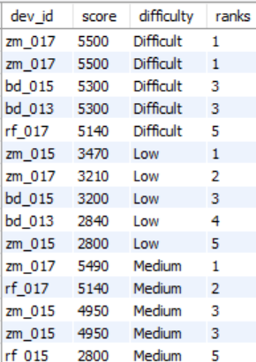
9. Find the top 5 scores based on each difficulty level and rank them in increasing order
using `Rank`. Display `Dev_ID` as well.
Select * from (Select dev_id , score , difficulty,
rank() over(partition by difficulty order by score desc) as ranks
from level_details) as results
where ranks<=5 ;

Slide 14
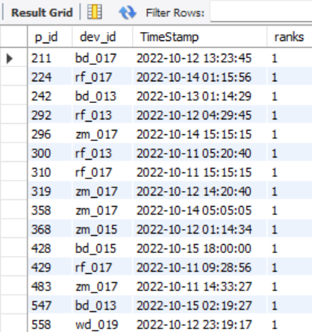
10. Find the device ID that is first logged in (based on `start_datetime`) for each player
(`P_ID`). Output should contain player ID, device ID, and first login datetime.
select * from ( select p_id , dev_id , TimeStamp ,
rank()over(partition by p_id order by TimeStamp) as ranks
from level_details) as result
where ranks=1;

Slide 15
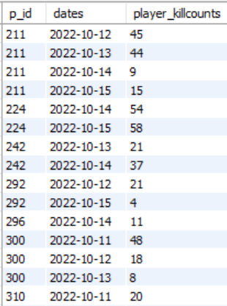
11. For each player and date, determine how many `kill_counts` were played by the player so far.
a) Using window functions
b) Without window functions
a) select p_id,dates ,player_killcounts from
(select p_id , date(TimeStamp) as dates, sum(kill_count) over(partition by p_id ,date(TimeStamp)) as player_killcounts,
row_number() over(partition by p_id ,date(TimeStamp)) as row_no
from level_details ) as result
where row_no =1;
b) Select p_id,Date(TimeStamp) as Dates,Sum(kill_count) as Kill_Counts
From level_details
Group by p_id,Date(TimeStamp)
order by p_id,Date(TimeStamp);

Slide 16
Select P_ID,TimeStamp, stages_crossed,Cumulative_of_Stages_crossed
from ( Select P_ID,TimeStamp,stages_crossed,
sum(stages_crossed) Over(partition by P_ID Order by
TimeStamp) as Cumulative_of_Stages_crossed,
Row_Number() Over(Partition by P_ID) as Row_NO
From level_details) as result
Where (P_ID,Row_NO)
NOT IN
(Select P_ID,MAX(Row_No) as Row_No
From (Select P_ID,TimeStamp,
sum(stages_crossed) Over(partition by P_ID Order
by TimeStamp) as Cumulative_of_Stages_crossed,
Row_Number() Over(Partition by P_ID) as Row_NO
From level_details) as Project
Group by P_ID);
12. Find the cumulative sum of stages crossed over `start_datetime` for each `P_ID`,
excluding the most recent `start_datetime`.

Slide 17
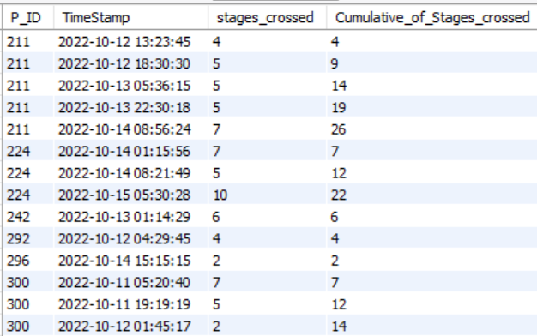

Slide 18
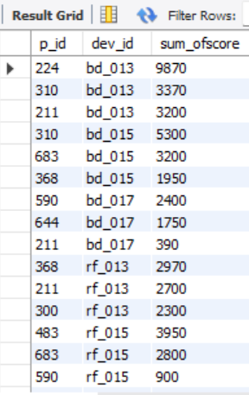
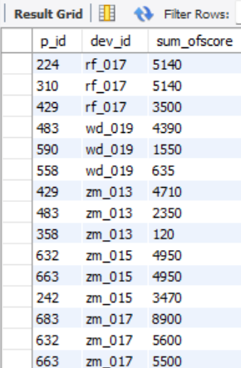
13. Extract the top 3 highest sums of scores for each `Dev_ID` and the corresponding `P_ID`.
select p_id, dev_id , sum_ofscore from
(select p_id , dev_id ,sum_ofscore,rank() over(partition by dev_id order by sum_ofscore desc ) as row_no from
(select p_id,dev_id,sum(score) as sum_ofscore from level_details
group by p_id,dev_id
order by sum_ofscore desc,dev_id asc ) as result1) as result2
where row_no<=3;

Slide 19
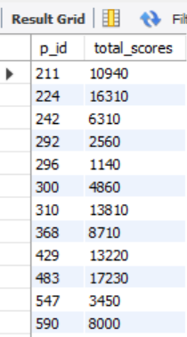
14. Find players who scored more than 50% of the average score, scored by the sum of
scores for each `P_ID`.
select p_id , sum(score) as total_scores from level_details
group by p_id
having sum(score)> 0.5*(select avg(score) from level_details)
order by p_id;

Slide 20
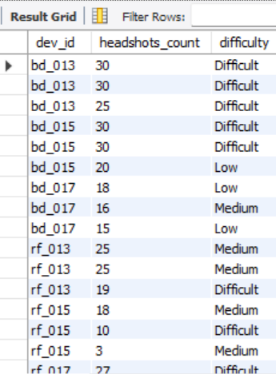
15. Create a stored procedure to find the top `n` `headshots_count` based on each `Dev_ID`
and rank them in increasing order using `Row_Number`. Display the difficulty as well.
DELIMITER //
CREATE PROCEDURE Top_N(IN Num INT)
BEGIN
SELECT dev_id, headshots_count, difficulty
FROM (
SELECT dev_id, difficulty, headshots_count,
ROW_NUMBER() OVER (PARTITION BY dev_id ORDER BY headshots_count DESC) AS row_no
FROM level_details) AS result
WHERE row_no <= Num;
END //
DELIMITER ;
CALL Top_N(3);

Slide 21
Key findings
➢The Device_id “zm_017” has crossed maximum stages i.e., 6 at Difficulty level.
➢ P_id 483 on ’13-10-2022 6:20’ has max kill count i.e., 134
➢ Total 19 players have played games on multiple days.
➢ Average of kill count by L1 code : Bulls_eye = 22.2500, Speed_Blitz = 19.3333, War_Zone = 19.2857
➢ Lives earned by level’s : Level 1 = 23 & Level 2 = 51
➢ Top Score’s on Difficulty Level are 5300 and 4570.

Slide 22
thank you

